Slide 1
WR & WTS Guyana Presentation

Slide 2
WR & WTS Energy: World at a Glance
We proudly distinguish ourselves by holding our Clients’ and Consultants’ best interests at the core of our operations
With 20 offices
across the world,
WTS Energy is a proud partner to major energy sector players
Our 20+ years of expertise in the Energy Industry now enable us to offer a full range of top-quality services, across several business lines
+ $90M
Yearly
Turnover
2000
Year
of Incorporation

Slide 3
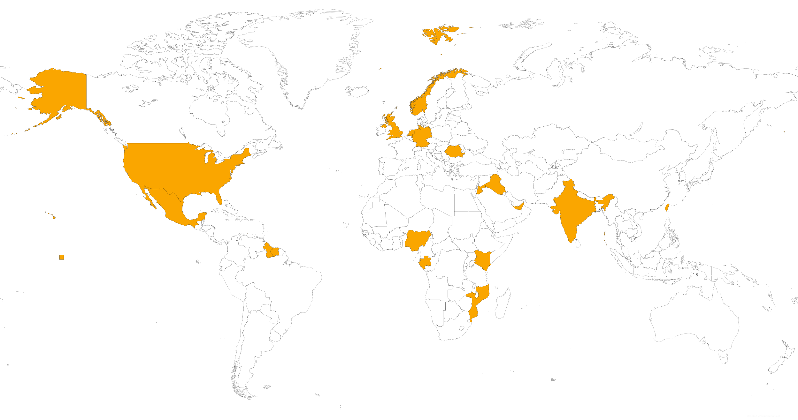
WTS Energy World at a Glance
Europe
Netherlands
UK
Romania
Norway
Germany
Soon: France
ME and Asia
Iraq
UAE
Taiwan
India
Jordan
Americas
USA
Mexico
Suriname
Guyana
Africa
Nigeria
Kenya
Mozambique
Gabon

Slide 4
WR & WTS Energy Philosophy
Mission statement
“To offer meaningful work around the world and help to protect the environment during the energy transition”
Company Values
Proactive, Focus & Persistence
Entrepreneurship & Innovation
Trustworthy & Honest
Down to Earth & Ambition

Slide 5
Our Partnership
Local Content Approved Company in Guyana
OPITO trainings ensuring worldwide HSE compliance
Working together to meet high standards of the Oil & Gas industry
360-Degree Services Scope to develop your projects

Slide 6
Sectors & Services
Oil & Gas
Engineering
Renewable Energy
HSE
Infra-structure
Logistics
Maritime + IT
Specialized Recruitment

Slide 7
Technical Services Scope
Training on Technical Skills,
HSE Trade Testing (onsite)
In House Project Management, Project Engineering
Trade Testing (onsite)
Supervision
20 Worldwide Offices Operational in 50 Countries
Full Operational Support
24/7
Local Logistic Support: Visa, Work Permits, Meet & Greet Services
Local and Global Insurance Coverage
Full Local Compliance: Taxes, Social Security Bluechip Approach
Extensive Track Record Managing Local & Expatriate Workforce

Slide 8
WTS Energy in the Americas
Strong footprint in Houston (2004) and Mexico (2016)
Think global,
act local
local content driven Organization Worldwide – providing Manpower services
Client list USA:, Schlumberger, EDP Renewables, Saipem, Tritium, Freeport LNG, GLDD, Halliburton
Providing technical services, recruitment, executive search. Team of 10 specialized recruiters in the energy industry
Client list: MODEC, ENI, Wintershall, Hokchi, Total, Cairn Energy, Borr Drilling

Slide 9
WTS Energy MEXICO - SUCCESFULL PROJECTS
CLIENT | PROJECT TYPE | PERIOD
Wintershall DEA | Exploration Drilling Campaign – Block 30 | 2020 – Ongoing
ENI | Exploration, Production and Drilling | 2017 – Ongoing
LukOil Upstream* | Exploration Drilling Campaign – Yoti-1* | 2020 – 2021*
SAIPEM | Rig Services: Jindal Pioneer | 2019 – 2020
CAPRICORN / CAIRN ENERGY | Exploration Drilling Campaign Block 9 | 2019 – 2020
TOTAL | Exploration Drilling Campaign Block 2 | 2018 - 2020
HOKCHI | Exploration Drilling and Plant Construction | 2018 – 2021
RENAISSANCE OIL CORPORATION | Field Operations and Development | 2016 - 2021
LUMEX OPERACIÓN | Field Operations and Development | 2017 – 2021

Slide 10
WR Recruitment
Director
Marvin Rigot
T: +592 220 6683
M: +592 682 5926
marvin@wr-recruitment-agency.com
www.wr-recruitment-agency.com
WTS Energy
Sales Manager
José Heriberto Arcos L.
M: +52 55 8006 1569
Jose.Arcos@wtsenergy.com
www.wtsenergy.com

